Slide 1
Psychology
Memory

Slide 2



Memory
www.tuf.edu.pk
unioffaisalabad

Slide 3
What is Memory
www.tuf.edu.pk
unioffaisalabad
Memory, a type of information processing, is the capacity to store, encode, and retrieve information.
Memory is the power to retain and recall information and past experiences.
It allows individuals to recall and draw upon past events to frame their understanding of and behavior within the present.

Slide 4
Stages of Memory
www.tuf.edu.pk
unioffaisalabad
Encoding:
Initial learning of information
Storing:
Maintaining information over time
Recall / Retrieving:
Access information when you need it

Slide 5
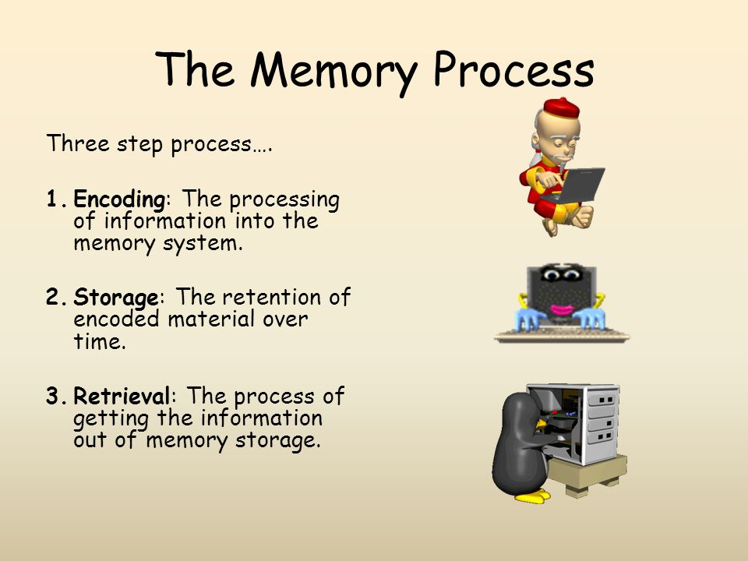
www.tuf.edu.pk
unioffaisalabad

Slide 6
Types of Memory
www.tuf.edu.pk
unioffaisalabad
Three major classifications of memory
Sensory memory, short-term memory, and long-term memory

Slide 7

Sensory Memory
www.tuf.edu.pk
unioffaisalabad
Sensory memories are stored for a few seconds at most. They come from the five senses: hearing, vision, touch, smell, and taste
Its a mental representation of how environmental events look, sound, feel, smell and taste.

Slide 8
Short Term Memory
www.tuf.edu.pk
unioffaisalabad
Short-term memory is the capacity to store a small amount of information in mind and keep it available for a short time.
In short term memory brain involved in remembering pieces of information for a short period of time, often up to 30 seconds.
It allows you to process and understand the information presented in real-time.

Slide 9
Working Memory
www.tuf.edu.pk
unioffaisalabad
Working memory is related to short-term memory, but it lasts slightly longer and is involved in the manipulation of information.
Information that used in the execution of cognitive tasks such as comprehension, problem solving, reasoning, and learning.
Working memory is important in attention, learning, and memory.

Slide 10
www.tuf.edu.pk
unioffaisalabad
Short Term Memory
Working Memory
While short-term memory is important for tasks such as remembering names, phone numbers, and other pieces of information that are needed.
In academic and professional settings, working memory is essential for tasks such as problem-solving, decision-making, and multitasking,

Slide 11
Long Term Memory
www.tuf.edu.pk
unioffaisalabad
Long-term memory refers to the transfer of information from short-term memory into long-term storage in order to creates long lasting memories.
These memories can be from an hour ago or several decades ago.
Long-term memory can hold an unlimited amount of information for an indefinite period of time.

Slide 12
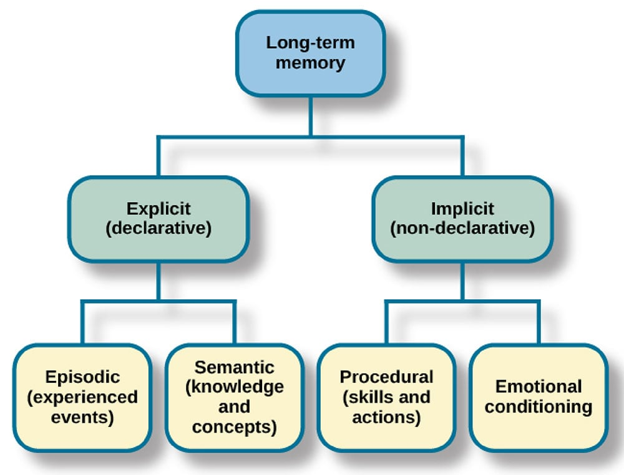
www.tuf.edu.pk
unioffaisalabad

Slide 13
www.tuf.edu.pk
unioffaisalabad
Explicit memories also known as declarative memories it include all of the memories that are available in consciousness.
Explicit memory can be further divided into episodic memory that are specific events and semantic memory known as knowledge about the world.

Slide 14
www.tuf.edu.pk
unioffaisalabad
Implicit memory surround all unconscious memories, as well as certain abilities or skills.
There are two types of implicit memory: procedural and emotional conditioning.

Slide 15
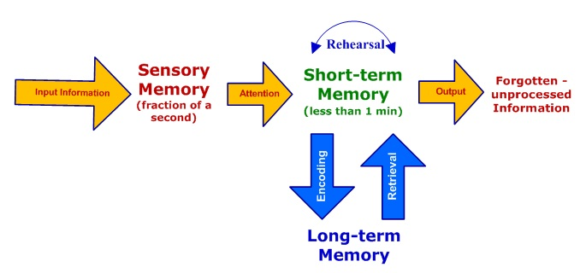
www.tuf.edu.pk
unioffaisalabad

Slide 16
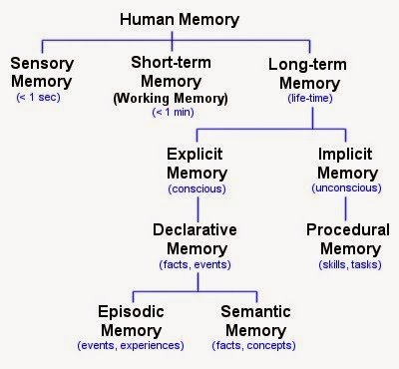
www.tuf.edu.pk
unioffaisalabad

Slide 17
Factor Affecting Memory
www.tuf.edu.pk
unioffaisalabad
Ability to retain: To keep or continue to recall something
Good health: A person with good health can retain the learnt material better than a person with poor health.
Age of the learner: Youngsters can remember better than the aged.
Maturity: Very young children cannot retain and remember complex material.
Sleep deprivation: Sleep deprivation can also negatively impact the prefrontal cortex resulting in a lack of focus and attention.

Slide 18
www.tuf.edu.pk
unioffaisalabad
Intelligence: More intelligent person will have better memory than a dull person.
Interest: If a person has more interest, they will learn and retain better.
Over learning: Over learning will lead to better memory.
Speed of learning: Quicker learning leads to better retention.

Slide 19
Method To Improve Memory
www.tuf.edu.pk
unioffaisalabad
Organize the information
Make associations
Use visual cues
Write it down
Say it out loud
Engage in active recall
Create meaningful groups
Exercise
Rehearse

